Slide 1
Object-Oriented Programming in JavaScript
- Keerti Vishwkarma

Slide 2
Agenda
Introduction to OOP
Core Principles of OOP
Inheritance
Abstraction
Polymorphism
Encapsulation
Real-Life Examples
Benefits of OOPs
Conclusion
Notes:
Welcome everyone to the session.
Outline the topics we’ll cover today.
By the end of this session, you’ll understand OOP concepts and how to implement them in JavaScript.

Slide 3

Introduction to OOP( Object-Oriented Programming)
Object-oriented programming is about creating objects that contain both data and methods.
OOP is faster and easier to execute.
OOP provides a clear structure for the programs.
OOP helps to keep the JavaScript code DRY "Don't Repeat Yourself", and makes the code easier to maintain, modify and debug.
Notes:
Welcome to this presentation on Object-Oriented Programming in JavaScript. Today, we'll dive into the core concepts of OOP, including features, classes, objects, methods, inheritance, abstraction, polymorphism, and encapsulation. JavaScript, while initially a functional programming language, now fully supports OOP principles, making it a versatile language for modern web development.

Slide 4
Core Principles of OOP
Inheritance
Polymorphism
Abstraction
Encapsulation
Notes:
JavaScript's OOP features include encapsulation, inheritance, polymorphism, and abstraction. Encapsulation helps in bundling the data and methods together. Inheritance allows us to create new classes based on existing ones. Polymorphism gives us the flexibility to process objects differently based on their class or data type. Lastly, abstraction helps us to hide the complex implementation details, exposing only the essential parts.

Slide 5
1. Inheritance
Mechanism to create a new class using the properties and methods of an existing class.
Allows a class to inherit properties and methods from another class.
To create a class inheritance, use the `extends` keyword.
Notes:
Inheritance lets a class inherit properties and methods from another class, promoting code reuse.

Slide 6

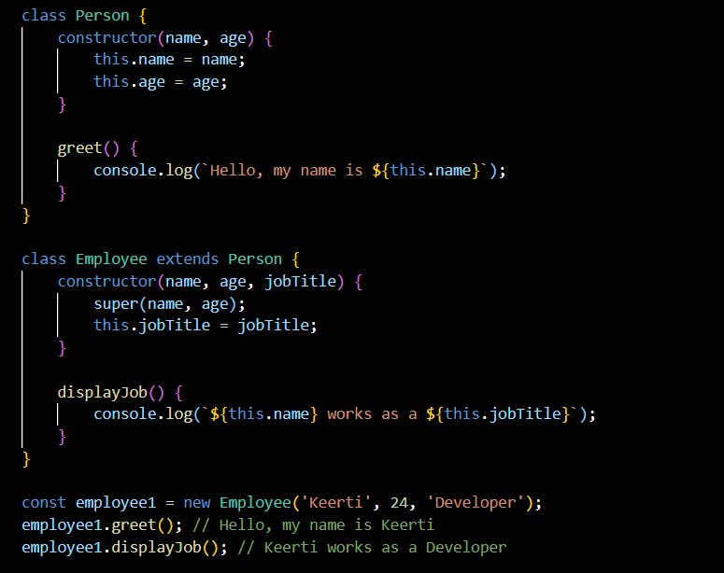
Example :
Notes:
Inheritance allows us to create new classes that reuse, extend, and modify the behavior defined in other classes. Here, Employee class extends the Person class, inheriting its properties and methods. We also add a new property jobTitle and a method displayJob.

Slide 7
2. Abstraction
Data abstraction refers to providing only essential information about the data to the outside world, hiding the background details or implementation.

Slide 8
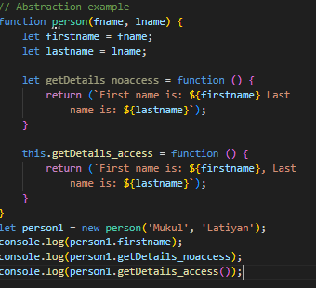
Example :
Notes:
Abstraction allows us to hide the complex parts of our code and expose only what’s necessary. In this example, the Car class has a method present that returns a string. The Model class extends Car and adds its own method show that builds on the present method.

Slide 9
3. Polymorphism
Polymorphism is one of the core concepts of object-oriented programming languages where poly means many and morphism means transforming one form into another.
Polymorphism is a concept used in the oops in JavaScript that enables us to use the same function in different forms.
Notes:
Polymorphism allows methods to do different things based on the object it is acting upon, even if they share the same name. In real life, for example, a boy at the same time may be a student, a class monitor, etc.

Slide 10
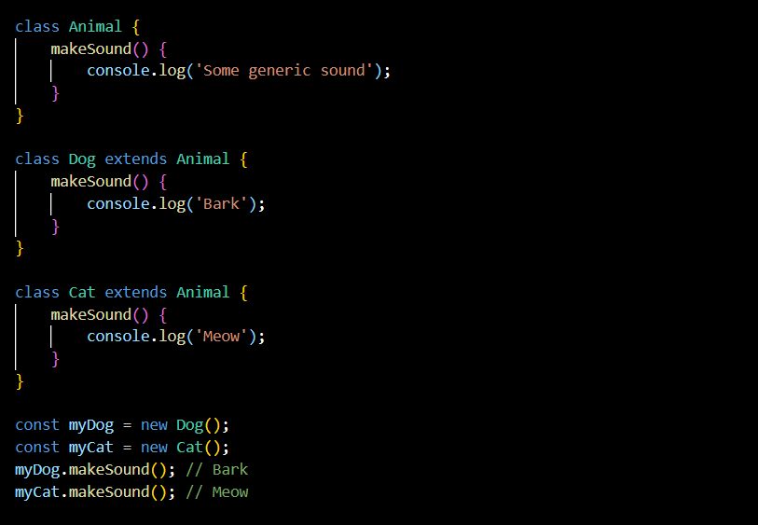
Example :
Notes:
Polymorphism allows objects to be treated as instances of their parent class, but each class can define its own behavior. In this example, both Dog and Cat classes extend Animal, but they each have their own makeSound method. When we call makeSound on instances of these classes, we get different outputs.

Slide 11
4. Encapsulation
Encapsulation puts the data variables and the data functions together inside a box.
The process of hiding data from outside the world is known as encapsulation.
Show how to restrict access to certain properties and methods using private fields (`#`)

Slide 12
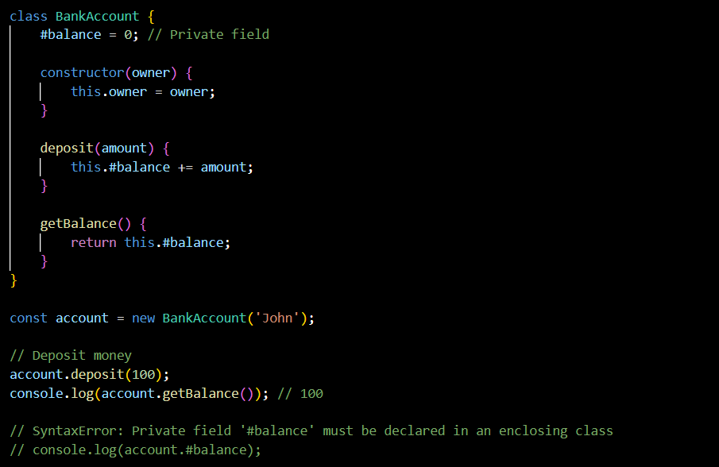
Example :
Notes:
Encapsulation is about restricting access to certain parts of an object to prevent unintended interference and misuse. Here, the BankAccount class uses a private field #balance to store the balance. This field is only accessible within the class, providing controlled access through methods like deposit and getBalance.

Slide 13

OOPS in Real-World Application
Creating a simple Task Management System App using JavaScript OOP concepts.
Demonstrates OOP principles.
Notes:
Let's see how these OOP principles come together in a real application

Slide 14
Task Management App

Slide 15
Benefits of OOPs
Code Reusability
Improved Debugging
Easy Maintenance
Scalability
Notes:
Using OOP in JavaScript offers several benefits: code reusability through inheritance, improved debugging due to modular code, easier maintenance, and better scalability for large applications.

Slide 16

Conclusion
Recap of OOP principles: i)Encapsulation ii)Inheritance iii)Polymorphism iv)Abstraction
Notes:
In conclusion, we've covered the key principles of Object-Oriented Programming: encapsulation, inheritance, polymorphism, and abstraction. These principles are fundamental to writing clean, maintainable, and scalable code in JavaScript. OOP is crucial for modern web development, allowing developers to build complex applications efficiently. I hope you found this session informative. Thank you for your attention, and I'm now open to any questions you may have.

Slide 17


